Slide 1
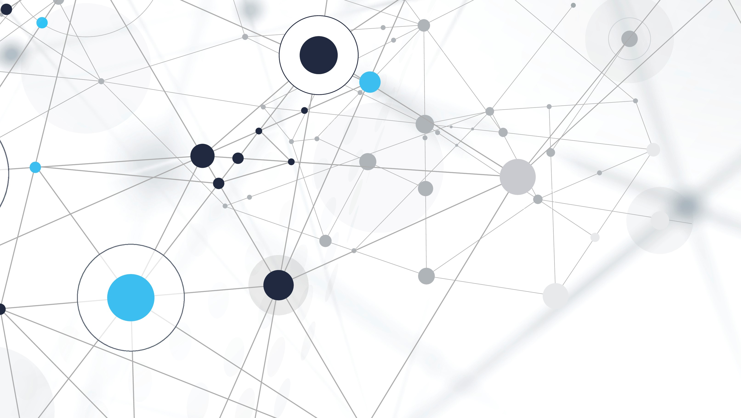
Interdisciplinary Group Project
Team Charter and Ways of Working

Slide 2
Agenda
team members
tools
values
data principles
Team Charter
ways of working

Slide 3
values
Respect - Treat each team member with respect and dignity, appreciating diverse backgrounds and experiences.
Inclusivity - Promote an inclusive environment where every member feels welcomed, valued, and safe to contribute.
Integrity - Act honestly and ethically in all project activities and communications.
Excellence - Strive for excellence through persistence, grit, and continuous improvement.
Thoughts? Amendments? Suggestions?

Slide 4
Principles
Accountability - Take personal responsibility for project work, communication and conducting ourselves ethically.
Collaboration - Work together effectively by openly sharing ideas, providing support, and valuing all contributions.
Communication - Communicate regularly through meetings, written channels, and informal discussions to stay aligned. Respond promptly to requests.
Thoughts? Amendments? Suggestions?
Consensus - Make project decisions through constructive discussion leading to consensus while considering diverse viewpoints.
Continuous learning - Commit to continuously developing skills, knowledge, and capabilities throughout the project.
Impact - Have a positive impact on end users and stakeholders through adding value and advancing knowledge. Seek root causes and fundamental solutions over temporary symptom relief.

Slide 5

Ways Of working

Slide 6


Agile
- Deliver work in short sprints with regular review, iteration, and adaptation based on feedback.
- Maintain a prioritised backlog, user stories and release plan to focus efforts.
Feedback
Sprint Backlog
24 H
Backlog
Sprint 1-2 weeks
Plan
Collaborate
Deliver

Slide 7
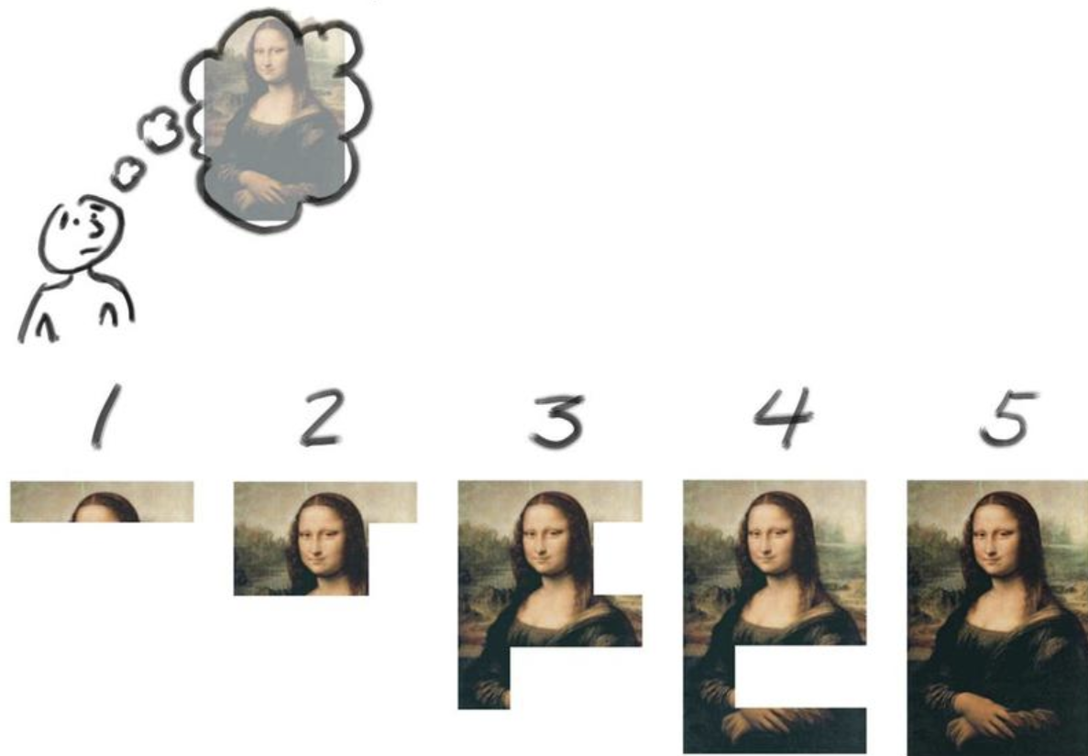
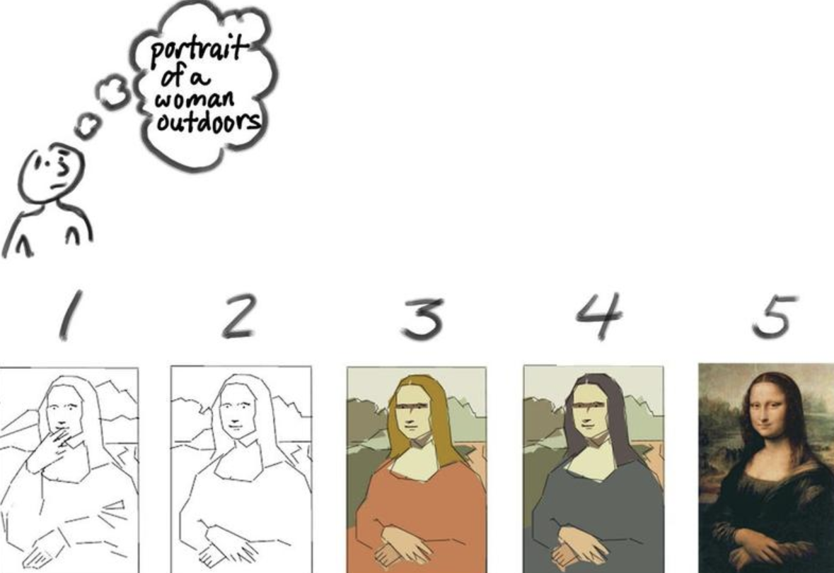
Incrementing v Iterating
https://wikiagile.fr/images/7/71/Usmp_iterative_0407.jpg https://wikiagile.fr/images/6/62/Usmp_incremental_0406.jpg

Slide 8
Coding and Programming
Pair programming - where possible, collaborate in pairs to increase skills, accelerate progress, and improve code quality.
Code review - Review code together to share knowledge, identify improvements, and fix defects.
Testing - Verify code correctness through unit, integration and user testing.
Version control - Use Git and GitHub for source control, collaboration, and release management.

Slide 9
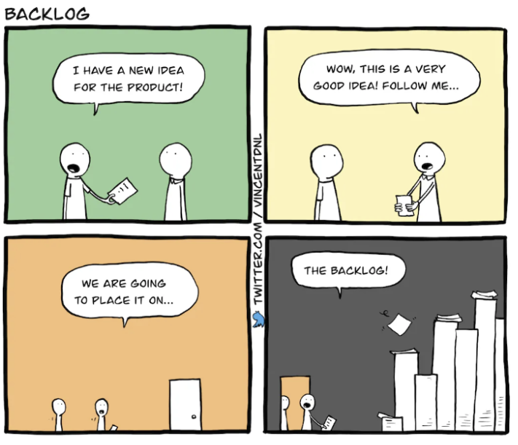
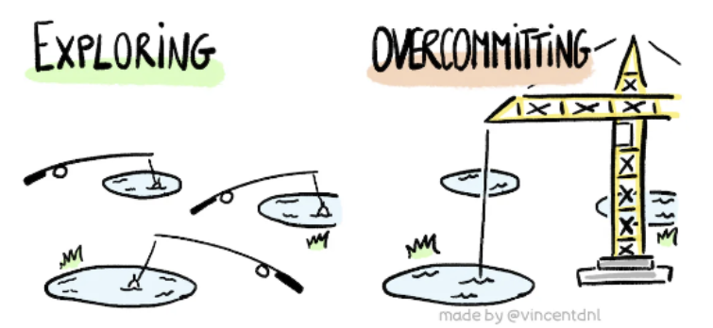
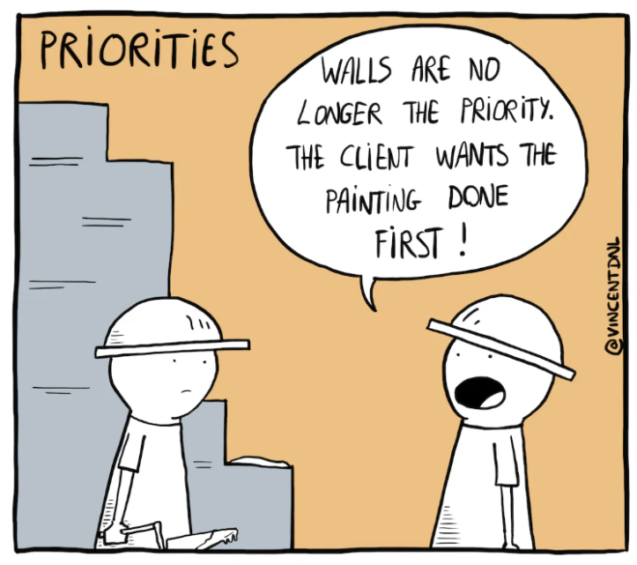
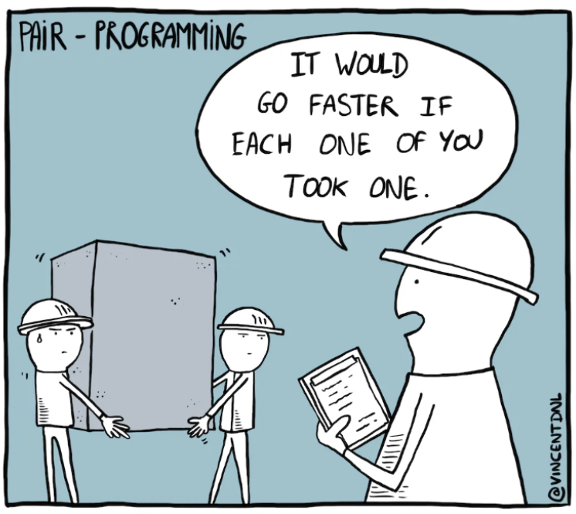
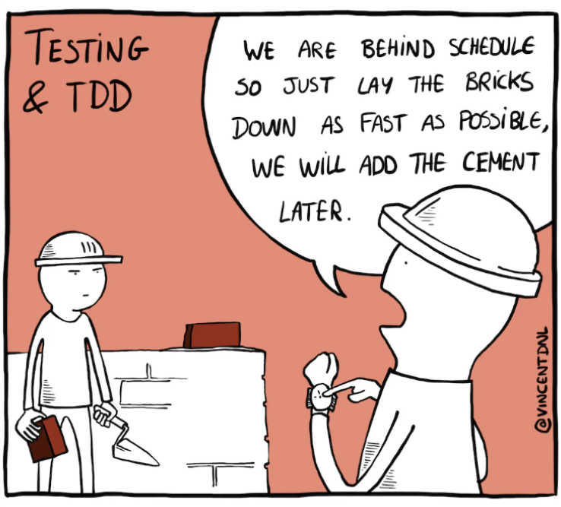
Some Humour…the Reality!
https://vincentdnl.com/drawings/markets
https://vincentdnl.com/drawings/backlog
https://vincentdnl.com/drawings/priorities
https://vincentdnl.com/drawings/pair-programming
https://vincentdnl.com/drawings/testing-tdd

Slide 10
Next to ADD
1. Conflict Resolution / Team Meetings / Communication
2. Data Principles
3. Tools
4. Demonstration and links
Trello – link to Board
Github – link to Repo
Zotero – link to group space
5. Team Charter template link
Tools

